Slide 1


EAGLE AIRLINES
Blockchain based Ticket Management System

Slide 2
GROUP-5 MEMBERS
DHIRAJ
PRASHANTH
LISHA

Slide 3
INTRODUCTION
BLOCKCHAIN BASED TICKET MANAGEMENT SYSTEM helps Eagle Airlines to develop a unique blockchain based ticket management system to entice users with transparency, and automated refunds and delay penalties.

Slide 4
OBJECTIVES
The airlines will deploy the contract with customer address and simulated dummy flight details (flight number, seat category, flight datetime, etc.)
The customer can transfer the ticket money to the contract
Customer can have a confirmation id and flight details in response from airlines
The customer should be able to trigger a cancellation anytime till 2 hours before the flight start time. A penalty already define by the airline can be deducted from the ticket charge. The penalty amount should be automatically sent to the airline account.
The airline should update the status of the flight within 24 hours of the flight start time. It can be ONTIME, DELAYED, CANCELLED, NOTSTARTED.

Slide 5
OBJECTIVES cont.
24 hours after the flight departure time, the customer can trigger to claim a refund. They should get a refund as predefined in the contract by the airlines.
If the airline hasn’t updated the status within 24 hours of the flight departure time, and a customer claim is made, it should be treated as an airline cancellation case by the contract
Any cancellation triggered by the airline should result in a complete amount refund to the customer.
Randomness and call-based simulation of various features like normal flights, cancellation by the airline, cancellation by the customer, and delayed flights.
Advanced Features:
Contract is supported for multiple cancellation penalties in favour of the airline, and delay penalties in favour of the customer, based on various time ranges in the contract.

Slide 6
PROCESS
Setting up a private Ethereum blockchain
Developing a base ticketing contract IN SOLIDITY
Connecting the blockchain and contract in remix using MetaMask

Slide 7
PROCESS
Building Ethereum Blockchain on AWS
Created 3 Ec2 machines (Ubuntu)
Installed geth on all the machines
Machine 1, Machine 2 and Machine 3 work as node1, node2 and node3 respectively
Boot node is created along with node1 in Machine 1
Two airline accounts are created on node2 and node3
4 Customer accounts are distributed among the 3 nodes
Created genesis block (used Clique)
Blockchain was made running on node1, node2 and node3 using the appropriate geth commands
The airline accounts act as sealers.

Slide 8
PROCESS
A base ticketing contract IN SOLIDITY Connecting it with Blockchain on AWS
A Contract Named “FlightReservation.sol” is written
All the required functions are added in it
The Private Blockchain created is added to MetaMask using “Add Networks”. There we give appropriate Network Name, RPC URL AND ChainID
In Remix IDE using web inject provider MetaMask, Blockchain and Contract is connected.

Slide 9
Working Methodology
Imported Accounts in MetaMask
Compile the contract and Deploy the contract with an airline account
Customer and Airline can use different functionalities like booking a ticket, cancelling a ticket or flight, updating the status etc., can be done.
It can be done via geth command line tool or via Remix connected to private blockchain

Slide 10
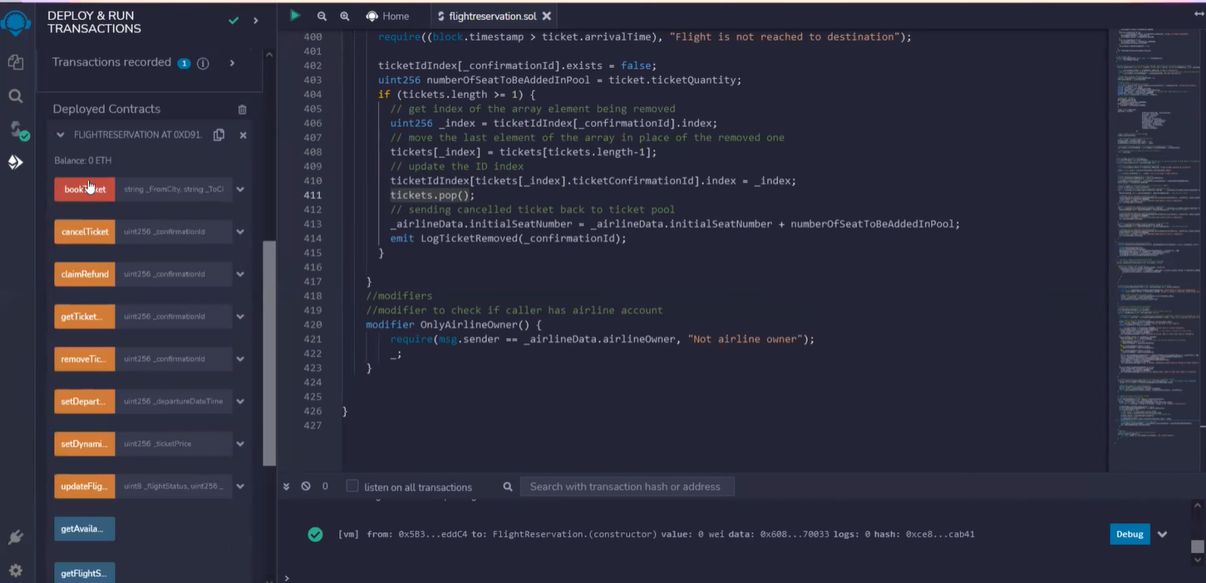
Output

Slide 11
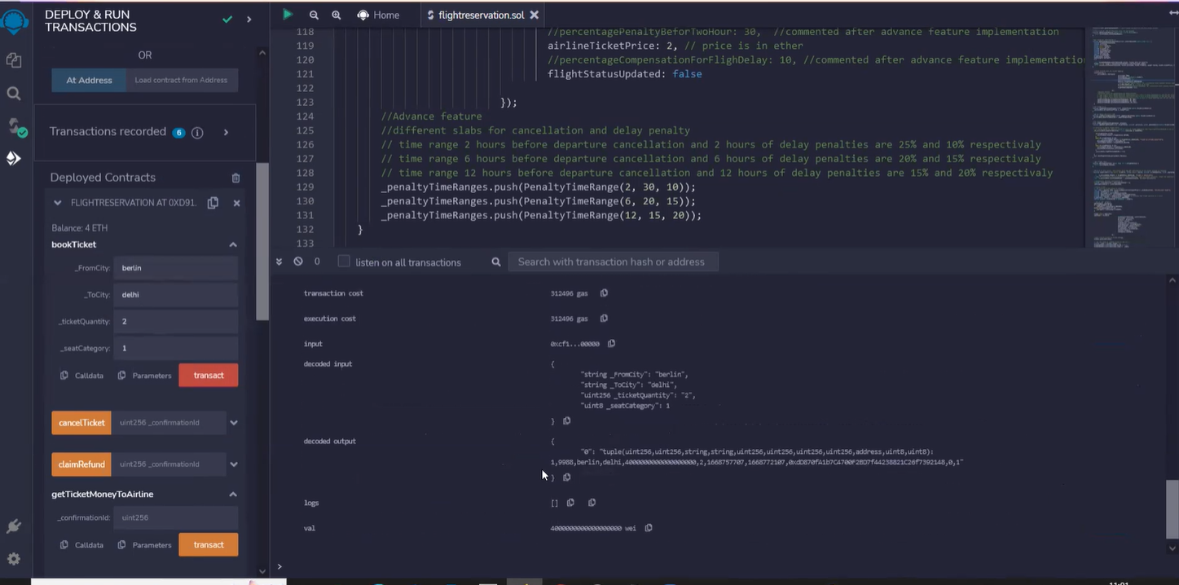
Output

Slide 12
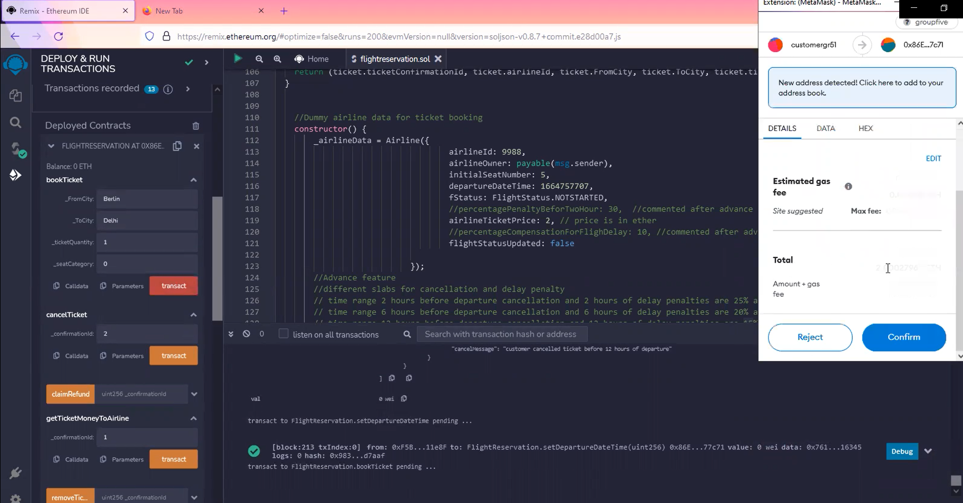
Output

Slide 13
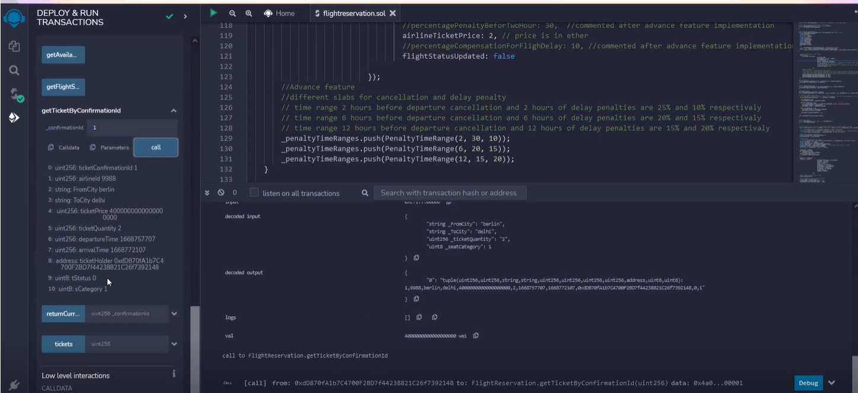
Output

Slide 14
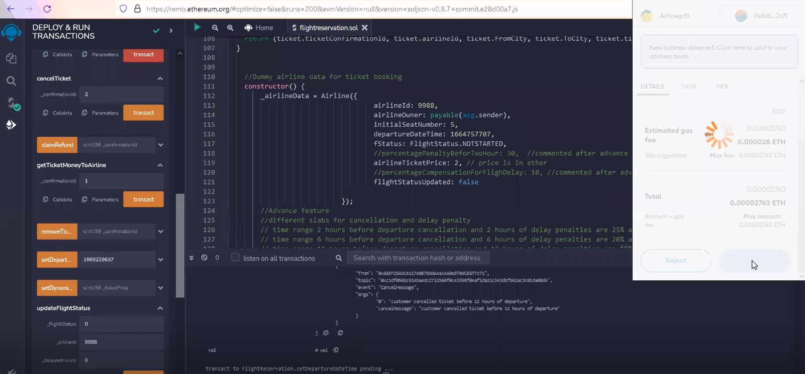
Output

Slide 15
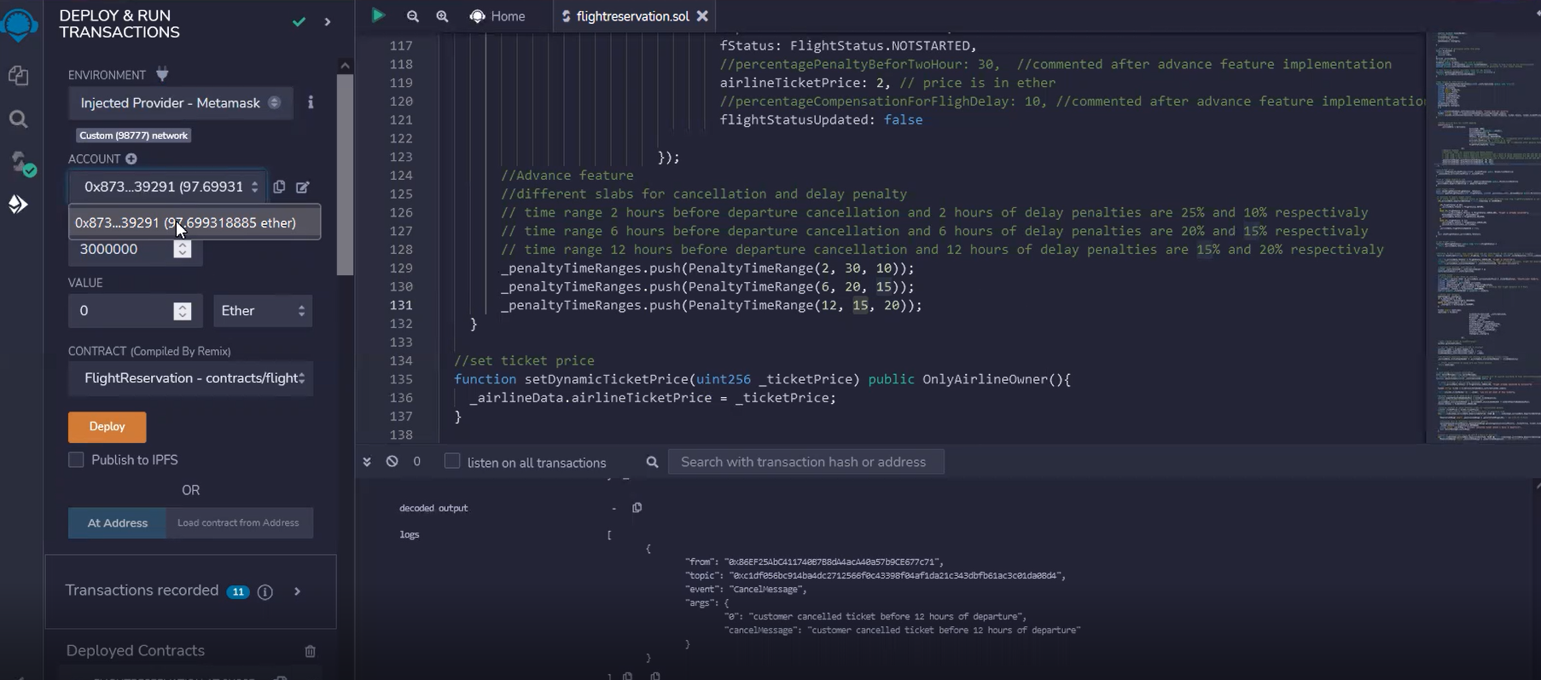
Output

Slide 16


